Slide 1
MEDT 8461: Project 1 - Interview
By: Canon Snow

Slide 2
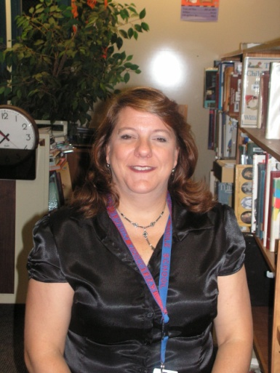
Interviewee Information
Name: Katie Elakman
Job Title: Media Specialist,
Education: B.S. in Education Middle Grades, Math/ Science, MED in Media, and a 6th year degree in Administration.
Job Description: My job at present is a Media Specialist and it entails management of a Media Center, ordering, updating, and troubleshooting both print and electronic materials.

Slide 3


Question: Being a media specialist, do you feel that technology has been well integrated into the current school curriculum?
Answer: I believe technology is getting there, but in our particular case we are still waiting on some key components in order to really integrate it into our curriculum. We have gotten laptops to all our teachers, and updated computers to all our classrooms, but Activboards and projectors are still lacking. Our wiring both electrically and network wise is not in place at the moment.

Slide 4

Question: What would be your definition of technological literacy and do you think our students are being given enough opportunities to become technologically literate?
Answer: My definition of technological literacy would be the ability to operate as well as integrate technology to express your ideas. Our students at this point are not being given sufficient opportunities, due to our constraints.

Slide 5

Question: Have you witnessed a technology integration that failed miserably?
Answer: Yes, mostly because of poor planning or equipment failure.

Slide 6


Question: What technologies have been integrated that, in your opinion, have succeeded?
Answer: We have one science classroom that has integrated a portable Activboard which students use on a daily basis.
Note* Activboards have been placed in most of the classrooms in Whitfield County

Slide 7

Question: What do you think is the biggest stumbling block in the way of technology integration? (hardware, training?)
Answer: Getting the hardware itself is not an issue; our wiring and infrastructure is at the moment. Once we get it in the hands of our teachers I think they will train each other.

Slide 8

Question: How does your school/school system go about adopting new technology?
Answer: Small purchases (made from local funds) are done through individual schools with guidelines as to brands they can purchase dictated from the technology department. Large purchases are done thru the technology department. The technology department determines appropriate upgrades and brands.

Slide 9


Question: What new technologies do you think we will see advocated in the future?
Answer: New version of windows operating system, new versions of Microsoft Office, podcasts, and the use of handheld portable computers.
Note* I agree, I think students will have the equivalent of Blackberries for use in every class. I also think this will replace the idea of a laptop for every student.

Slide 10



Question: If you were king/queen, what would you like to see in school classrooms?
Answer: Activboards in classrooms, and handhelds for all students.

Slide 11


Question: In your opinion is the Internet something to be shielded from or used more often?
Answer: I think we need to be using the internet more, but we need to find a way to ensure both safety and reliability when using it as well as a way to shield out inappropriate material.

Slide 12
Thoughts From Me….
Click the final thought icon below

